Slide 1


Key Performance Indicators: An Introduction to Winning KPIs
Facilitated by:
Dr. Haroon Rashid
February 23, 2017
Millat Tractors Limited
A Project of UMT
A Project of UMT

Slide 2
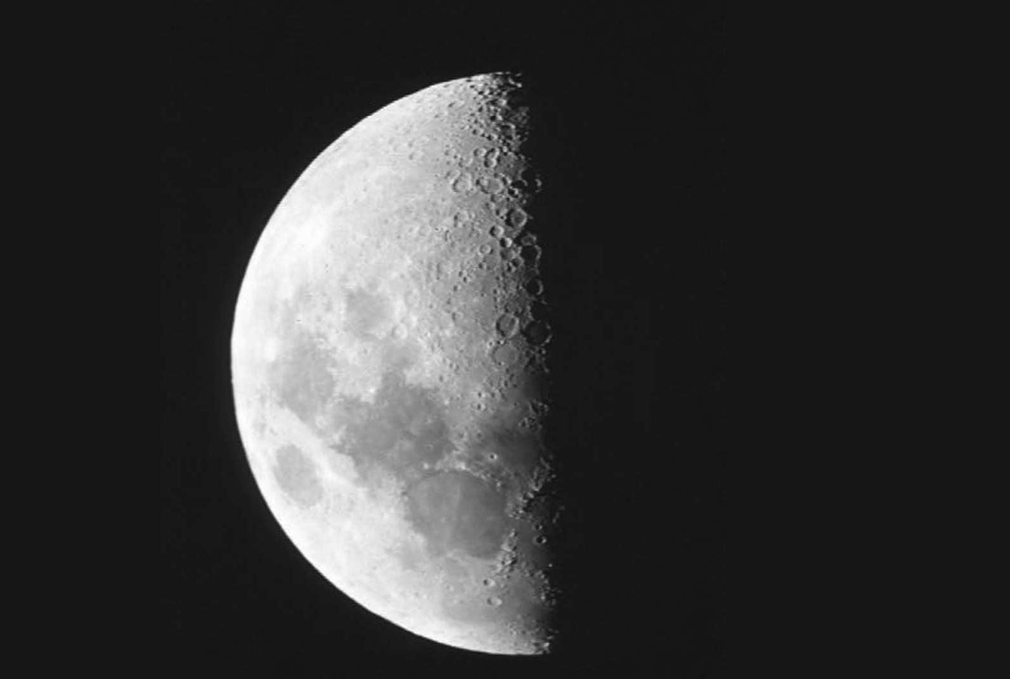
All measures have a dark side

Slide 3
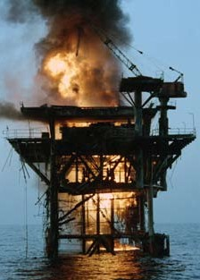
We have a burning platform
Often a random collection prepared with little expertise signifying nothing
Mixture of operational and governance measures
Not prioritizing (lack of CSFs)
Used for monitoring people not processes (political indicators)
Too late

Slide 4

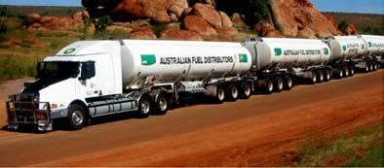
So what are KPIs?
Two KPI stories
Airline
Freight forwarding company

Slide 5
The Characteristics of KPIs
Non-financial measures (not expressed in , ¥, £, $)
Measured frequently, e.g., daily or 24 by 7
Acted upon by CEO and SMT
Clearly indicate what action is required by staff
Are measures that tie responsibility to a team or group of closely connected teams
Have a significant impact, e.g., affects more than one CSF and BSC perspective
Encourage appropriate action, e.g., have only a small dark side

Slide 6
Definition of a KPI
KPIs focus on the aspects or areas of an organization’s performance that are critical or vital for its ongoing and future success.
(Source: AusIndustry KPI Manual)
Late deliveries to key customers
Recognitions planned for next week/fortnight
Outstanding job offers, over 24 hours old
Resignations from key staff (in last hour)
Unresolved key customer complaints (over 4 hours)

Slide 7
The role of performance measures
Establish current position
Communicate direction
Achieve a more balanced performance
Stimulate action link to the organization’s critical success factors (behavioural alignment)
Facilitate learning
To get our organization future-ready

Slide 8
Changing this
Team direction
Strategic direction

Slide 9
To this
Team in alignment with strategy

Slide 10
Background, KPI stories, and the
balanced scorecard
Myths of performance measurement
The next steps
KPIs
Foundation stones and the six-stag process
Four types of PMs
e
Critical success factors

Slide 11
Some myths of performance measurement that are undermining performance
By tying KPIs to pay you will increase performance
Most measures lead to better performance
All performance measures are KPIs
Monitoring monthly performance measures will improve performance
KPIs are financial and non financial indicators

Slide 12
Myth: By tying KPIs to pay you will increase performance
What happened to Maslow’s hierarchy of needs?
Performance with KPIs should be treated as a ‘ticket to the game’
Jack Welch
KPIs are too important to be manipulated
Self - Actualisation Pursue inner talent
Creativity • Fulfillment
Self - Esteem Achievement • Mastery Recongition • Respect
Belonging - Love
Friends • Family • Spouse • Lover
Safety
Security • Stability • Freedom from fear
Physiological
Food • Water • Shelter • Warmth
Maslow’s Heirarchy of Needs
Otherwise KPIs now stand for key political indicators

Slide 13
Linking bonuses to balanced scorecard will fail
Measures manipulated
Lack of linkage to critical success factors
Weighting of measures leads to crazy agreements
Perspective weighting
Measure weighting
Category
Measure
Financial | 60% | Economic value added | 25%
 |  | Units profitability | 20%
 |  | Market growth | 15%
Customer | 20% | Customer satisfaction survey | 10%
 |  | Dealer satisfaction survey | 10%
Internal | 10% | Above average rank on process industry quality survey | 5%
 |  | Decrease in dealer delivery cycle time | 5%
Income and learning | 10% | Suggestions/employee | 5%
 |  | Satisfaction survey | 5%

Slide 14
The ultimate goal is not the customer it’s often the scorecard.
I have heard executives, when being candid, say, ‘We don’t worry about strategy we just move our numbers and get rewarded’.
Dean Spitzer

Slide 15
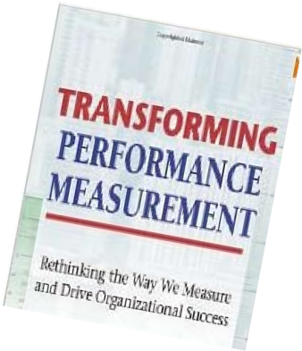

Myth: Most measures lead to better performance
Unintended consequence of performance measures
  Dean Spitzer’s book
Social workers assigning difficult cases to inexperienced staff
Zero wastage of chicken in fast food outlet
  leads to zero customers
Accident and emergency department story
Sydney train service story

Slide 16
Myth: All performance measures are KPIs
Is there a definition for KPIs in your organisation?
How can a monthly measure be key to the business — it is too late
Surely some measures are not key — they are simply PIs
I have come to the conclusion that there are four types of performance measures

Slide 17
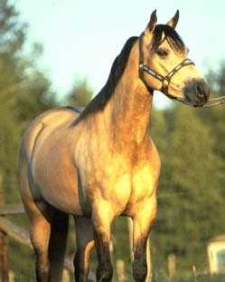
Myth: Monitoring monthly performance measures will improve performance
Monthly measures seldom change anything
Information is too late
e.g. it is as useful as telling a trainer that his prize horse escaped the stables, sometime last month!

Slide 18
Myth: KPIs are financial and non financial indicators
In reality many measures have never been KPIs.
KPIs have special characteristics including:
Non financial measures (not expressed in £, , ¥, $)
Measured frequently e.g. daily or 24 by 7
•
•
Acted upon by CEO and senior management team
All staff understand the measure and what corrective action is required
Responsibility can be tied down to a team or a group of teams working closely together
Significant impact e.g. it impacts most of the core CSFs and more than one BSC perspective
Has a positive impact in the right direction e.g. minimum dark
side

Slide 19
Background, KPI stories, and the
balanced scorecard
Myths of performance measurement
The next steps
KPIs
Foundation stones and the six-stag process
Four types of PMs
e
Critical success factors

Slide 20
Two groups of two
Result Indicators | Measures that summarize the collective effort of a wide number of teams. Some of these result indicators summarize the collective efforts of all the teams. I call these Key Result Indicators.
Performance Indicators | Measures where the responsibility can be tied down to a team or a cluster of teams who work closely together. Some of these performance indicators tell staff and management what to do to increase performance dramatically. I call these Key Performance Indicators.

Slide 21
Four types of Performance Measures (10/80/10)
Key result indicators 10 (Board KPIs)
give overview of the organization’s past performance and are ideal for the Board
summarize activities of a number of teams and thus
80 have a shared responsibility
can be tied back to a team but are not ‘key’ to the business
10 can be tied back to a team and are critical for the organization’s current and future success
Result indicators
Performance indicators
Key performance indicators (Operational KPIs)

Slide 22
KRIs are measures often mistaken for KPIs and include:
Customer satisfaction (%)
Employee satisfaction (%)
Return on capital employed (%)
Net profit before tax and interest ($)

Slide 23
Examples of result indicators
Complaints from key customers
Sales made yesterday
Bed utilization in week
Number of products rejected by quality assurance
Debtor collections in week

Slide 24
Examples of performance indicators
Percentage increase in sales to top 10% of customers
Employees’ suggestions implemented in last 30 days
Sales calls organized for the next week, fortnight
Customer complaints
Late deliveries

Slide 25
Four types of Performance Measures
Customer satisfaction Employee satisfaction Return on capital employed
Late planes
Late deliveries to key customers Resignations of key staff
Past
Current
Future
KRIs
KPIs
KPIs
KPIs
PIs
PIs
PIs
RIs
RIs
RIs
Last
quarter
Last
month
Next
month
Next
quarter
Last
year
Last
week
Next
week
# of employees’ suggestions implemented in last 30 days, sales calls organized for the next week/fortnight, late deliveries to customers
Debtor collections in week Bed utilization in week Weekly sales

Slide 26
Background, KPI stories, and the
balanced scorecard
Myths of performance measurement
The next steps
KPIs
Foundation stones and the six-stag process
Four types of PMs
e
Critical success factors

Slide 27
Critical success factors
Mission / Vision / Values / Principles
Strategies (objectives & initiatives)
Financial results
Customer satisfaction
Innovation & learning
Internal processes
Staff satisfaction
Community & environment
Operational critical success factors
Key result indicators (max 10)
Result indicators & performance indicators (80 or so)
Key performance indicators (max 10)
Financial results
Customer satisfaction
Innovation & learning
Internal processes
Staff satisfaction
Community & environment

Slide 29


The hierarchy of success factors
Critical success factors
Success factors

Slide 30
Most organizations know their success factors
However, few organizations:
Word their success factors appropriately
Segregate out success factors from their strategic objectives
Sift through them to find their critical ones
— their CSFs
Communicate CSFs to staff

Slide 31
Step 4: Communicate CSFs to the staff

Slide 32
Background, KPI stories, and the
balanced scorecard
Myths of performance measurement
The next steps
KPIs
Foundation stones and the six-stag process
Four types of PMs
e
Critical success factors

Slide 33
We need solid foundation stones for winning KPIs
Partnership with the staff, unions, and 3rd parties
Transfer of power to the front line
Measure and report only what matters
KPIs are sourced from the critical success factors
Abandon processes that do not deliver
Home grown Chief Measurement Officer
Organization-wide understanding of KPIs definition

Slide 34
The six-stage process in the 3rd edition
Stage | Steps | Project week | pre | 1 | 2 | 3 | 4 | 5 | 6 | 7-11 | 12-16 | post
1 | 1, 4 | Getting the CEO, senior leadership team, management and staff committed to the change
2 | 2, 3 | Up-skill in-house resources to manage the KPI project
3 | 5 | Leading and selling the change
4 | 6 | Ascertain the key aspects that need to be done well day-in day-out (the operational CSFs)
5 | 7, 8, 9 | Determine the measures that will work in your organization
6 | 10,11,12 | Get the measures to drive performance
Making the process easy to work with
A homage to Kaizen
Based on further observations and reflection

Slide 35
Background and KPI
stories
The next steps
Balanced scorecard
KPIs
Foundation stones and the six-stag process
Four types of PMs
e
Critical success factors

